Slide 1
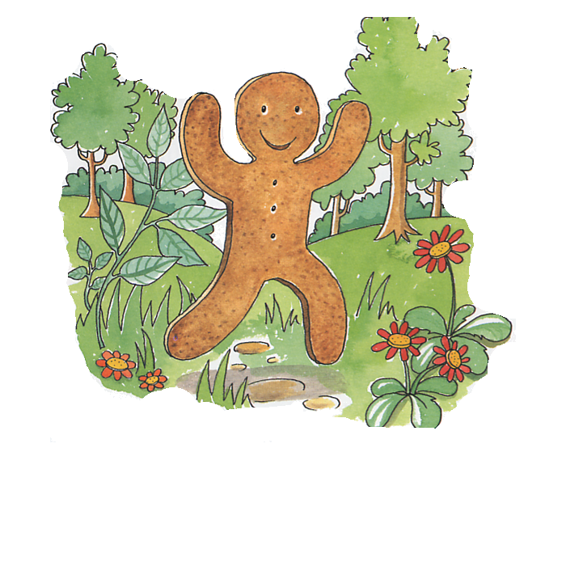
The Gingerbread Man
Story retold by Bev Evans

Slide 2
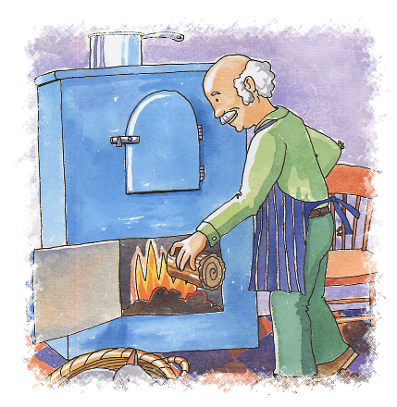
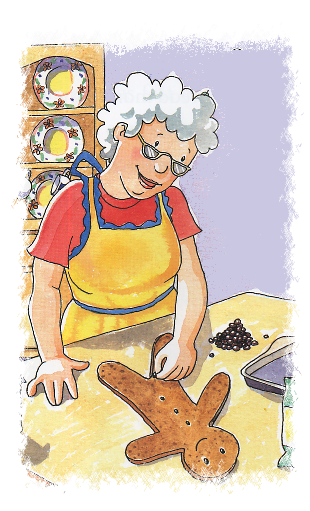
Once upon a time there was a little old woman and a little old man who lived in a little cottage.
The little old man got the oven ready……
…and the little old lady started baking.
One day, the little old lady decided to make a gingerbread man.

Slide 3
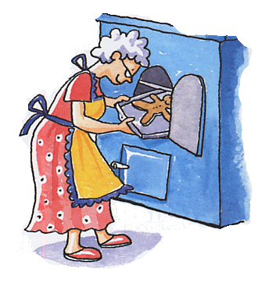
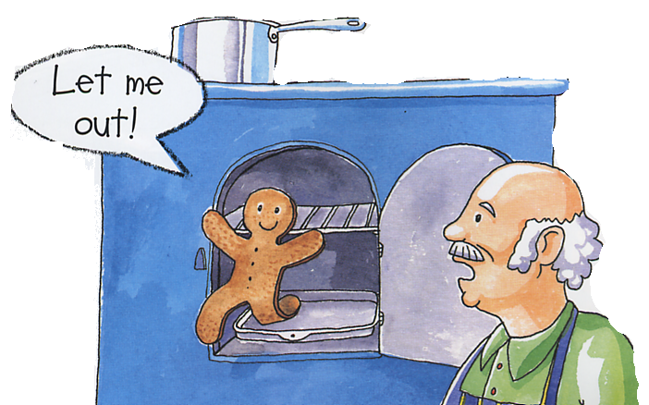
The little old lady carefully placed her gingerbread man in the oven to bake.
Soon there was a noise coming from the oven!
It was the gingerbread man.
He ran out of the oven and straight out of the front door.

Slide 4
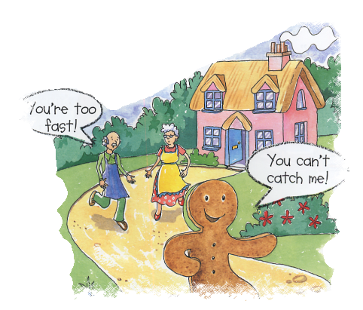
“Stop, little gingerbread man!” cried the little old man and the little old woman.
But the gingerbread man would not stop!
The gingerbread man did not want to be eaten, so he shouted…
“Run, run, as fast as you can. You can’t catch me - I’m the gingerbread man!”
And off he ran, all the way along the lane to the garden gate.

Slide 5
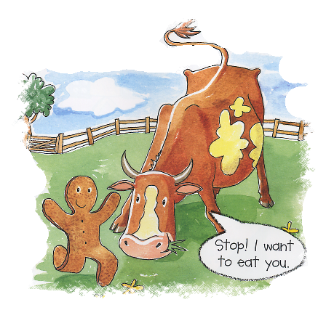
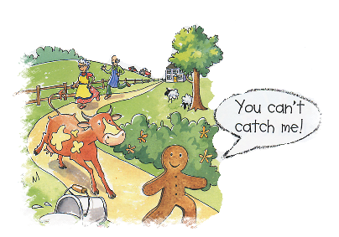
Soon he came to a cow’s field.
“You will have to catch me first!” shouted the gingerbread man.
“Run, run, as fast as you can! You can’t catch me – I’m the gingerbread man!”
“You look tasty,” said the cow, “ I think I’ll eat you for my tea!”

Slide 6
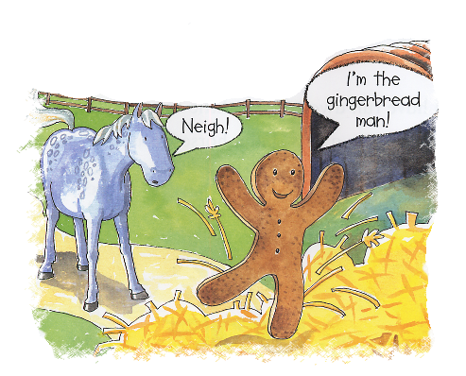
Next, the gingerbread man came to a horse in a stable.
“You will have to catch me first!” shouted the gingerbread man.
“Run, run, as fast as you can! You can’t catch me – I’m the gingerbread man!”
And off he ran towards the stream.
“You look tasty,” said the horse, “ I think I’ll eat you for my tea!”

Slide 7
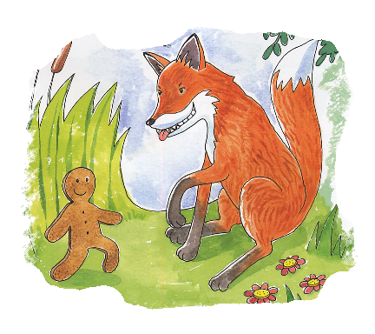
“Why are you running away?” asked the sly fox.
“They all want to eat me!” said the gingerbread man.
“I think I need to cross the stream!”
At the edge of the stream stood an old sly fox.

Slide 8
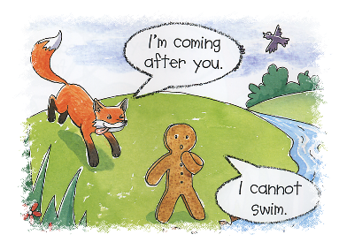
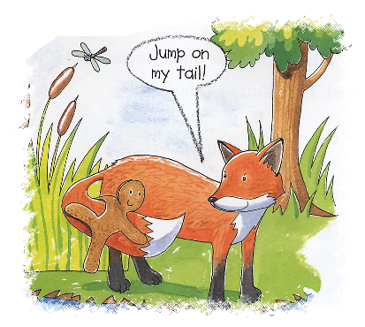
“I can help you,” said the fox, “You can hold onto my tail while I swim across.”
And that’s just what the gingerbread man did.
“I’m so pleased I met you!” exclaimed the gingerbread man.

Slide 9
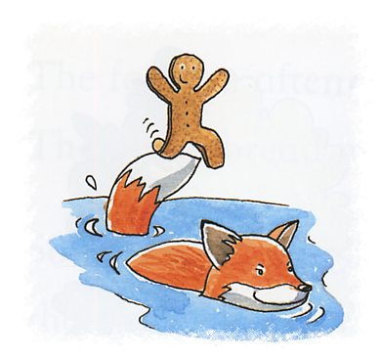
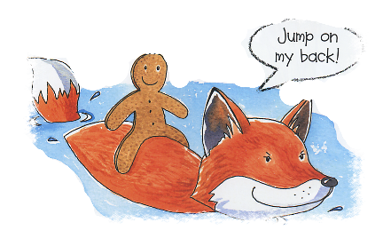
“My feet are getting wet!” shouted the gingerbread man.
“Then jump on my back,” said the sly fox.
They had been swimming for a little while when, all of a sudden……

Slide 10
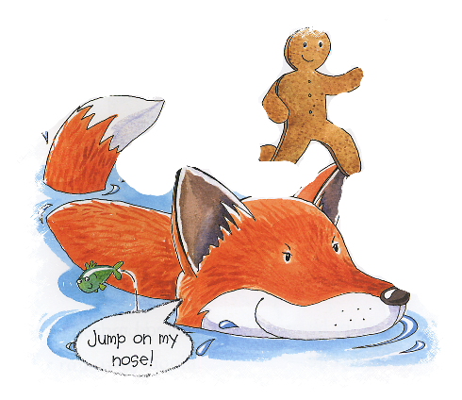
They swam a little further when……
“Oh no! I’m getting wet again!”
“Well, jump on my ears,” replied the sly fox.
But the gingerbread man was still getting wet.
Eventually, the sly fox said, “Why don’t you jump on my nose?”
So the gingerbread man jumped, but……

Slide 11
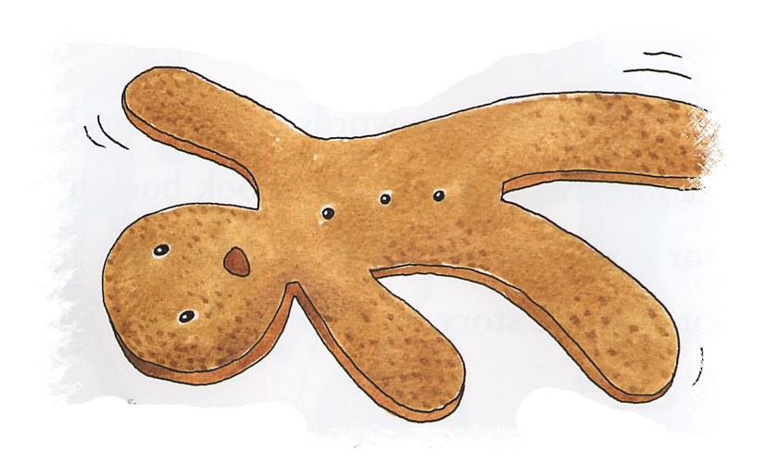
…just as he did the sly fox tossed the gingerbread man high into the air……
…… and ate him up in one, BIG, bite!

Slide 12
The End
Story retold by Bev Evans www.communication4all.co.uk
Images by Ruth Galloway ©Parragon books

