Slide 1
Year 1 – Spring Block 4 – Weight and Volume – Measure Mass
About This Resource:
This PowerPoint has been designed to support your teaching of this small step. It includes a starter activity and an example of each question from the Varied Fluency and Reasoning and Problem Solving resources also provided in this pack. You can choose to work through all examples provided or a selection of them depending on the needs of your class.
National Curriculum Objectives:
Mathematics Year 1: (1M1) Compare, describe and solve practical problems for: lengths and heights [for example, long/short, longer/shorter, tall/short, double/half] mass/weight [for example, heavy/light, heavier than, lighter than] capacity and volume [for example, full/empty, more than, less than, half, half full, quarter] Time [for example, quicker, slower, earlier, later]
Mathematics Year 1: (1M2) Measure and begin to record: lengths and heights mass/weight capacity and volume time (hours, minutes, seconds)
More Year 1 Weight and Volume resources.
Did you like this resource? Don’t forget to review it on our website.
© Classroom Secrets Limited 2019

Slide 2
Year 1 – Spring Block 4 – Weight and Volume
Step 2: Measure Mass
© Classroom Secrets Limited 2019

Slide 3
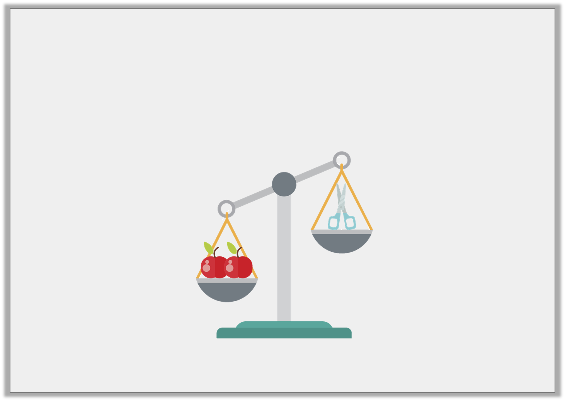
Introduction
Fill in the blanks using the words on the cards.
The scissors are _________________________________ than the apples.
The apples are _________________________________ than the scissors.
heavier
lighter
© Classroom Secrets Limited 2019

Slide 4
Introduction
Fill in the blanks using the words on the cards.
The scissors are _________________________________ than the apples.
The apples are _________________________________ than the scissors.
lighter
heavier
heavier
lighter
© Classroom Secrets Limited 2019

Slide 5
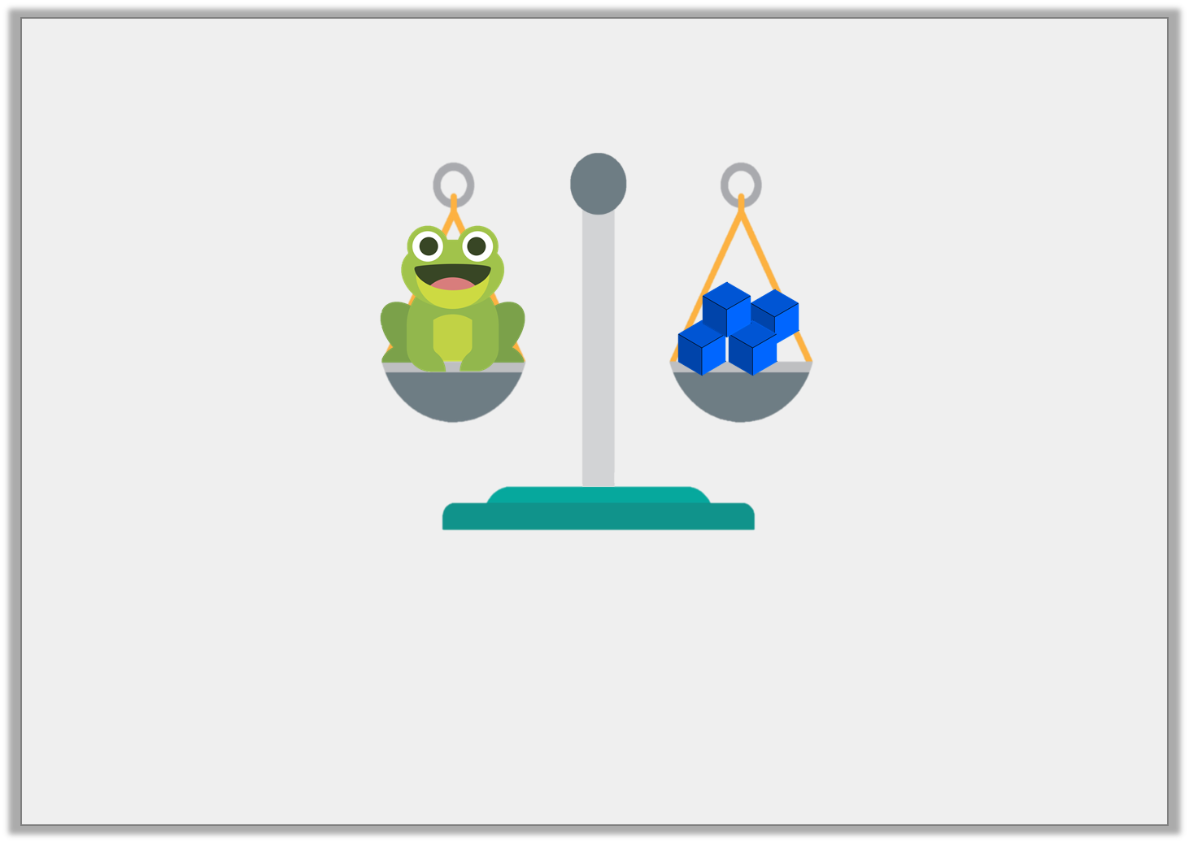
Varied Fluency 1
What is the mass of the toy frog?
cubes
© Classroom Secrets Limited 2019

Slide 6
Varied Fluency 1
What is the mass of the toy frog?
cubes
4
© Classroom Secrets Limited 2019

Slide 7
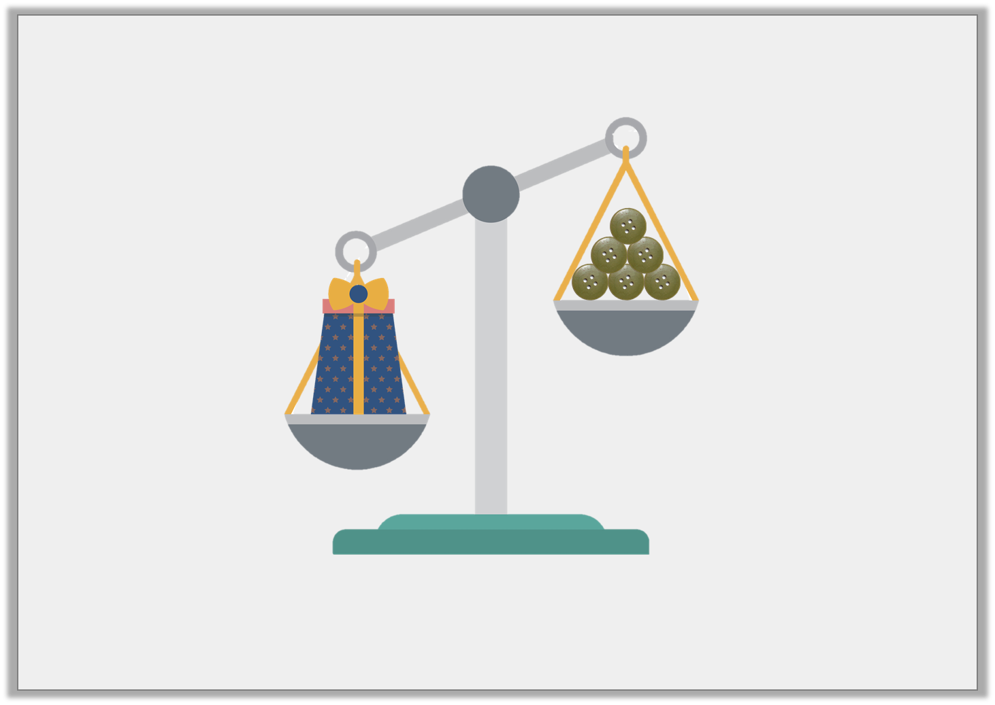
Varied Fluency 2
True or false? This box weighs less than 6 buttons.
© Classroom Secrets Limited 2019

Slide 8
Varied Fluency 2
True or false? This box weighs less than 6 buttons.
False, the box weighs more than 6 buttons.
© Classroom Secrets Limited 2019

Slide 9
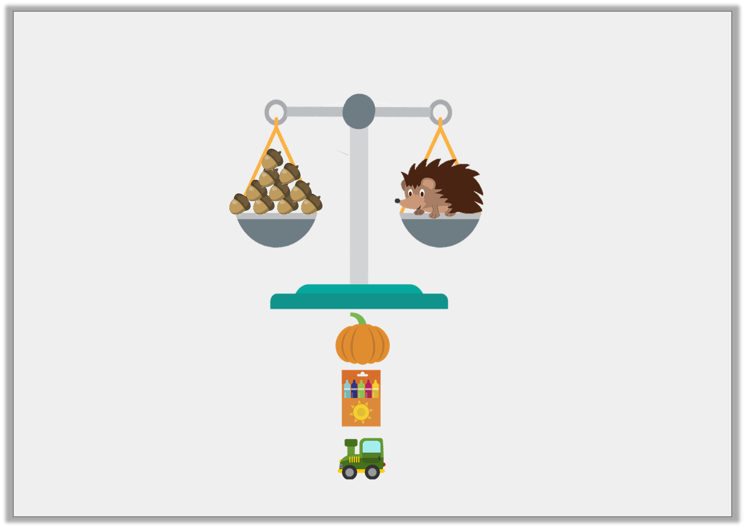
Varied Fluency 3
Which object weighs more than the hedgehog?
pumpkin
crayons
toy
12 acorns
8 acorns
10 acorns
© Classroom Secrets Limited 2019

Slide 10
Varied Fluency 3
Which object weighs more than the hedgehog?
pumpkin
crayons
toy
12 acorns
8 acorns
10 acorns
© Classroom Secrets Limited 2019

Slide 11
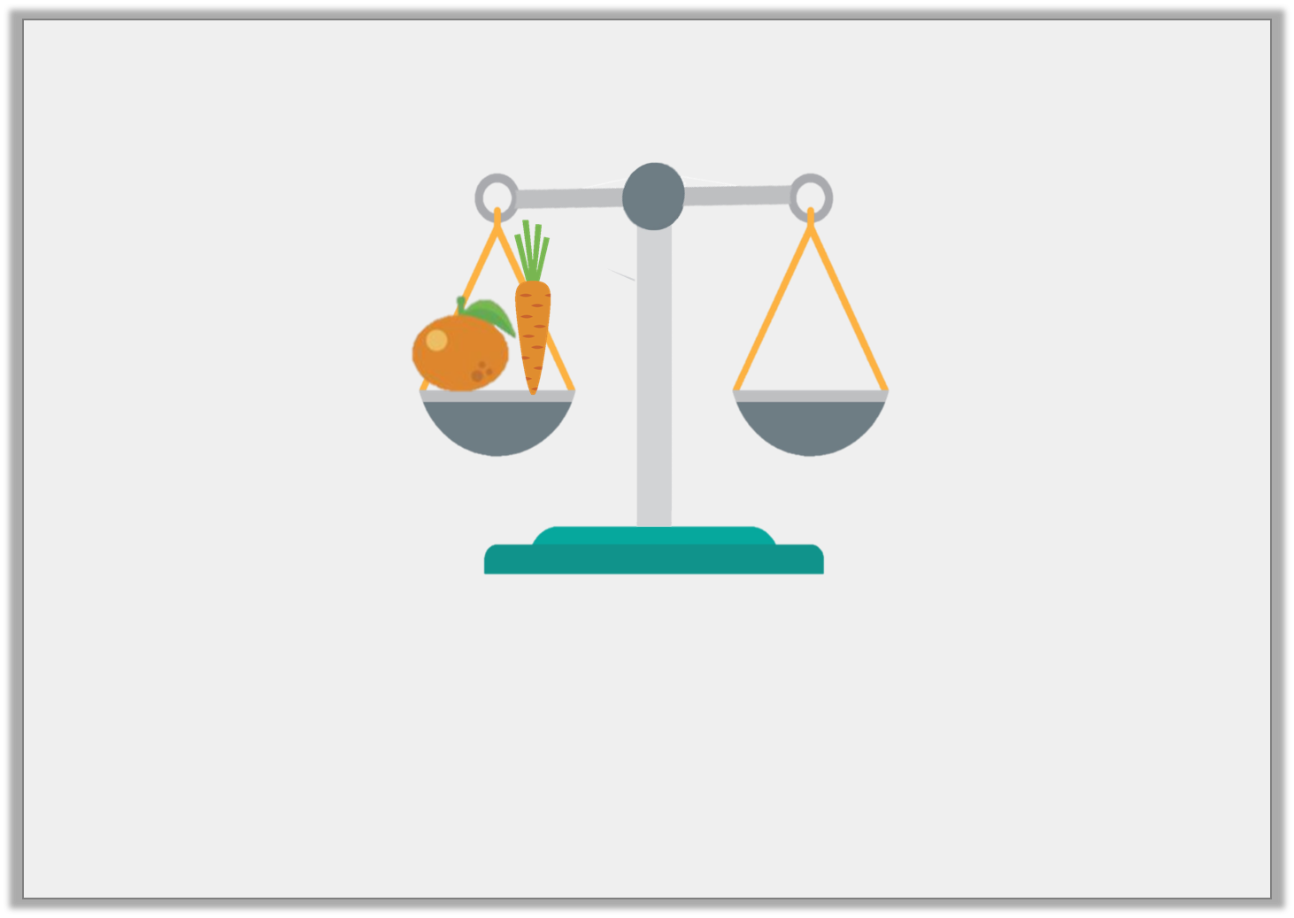
Problem Solving 1
The orange weighs 7 blocks and the carrot weighs 5 blocks.
Draw the blocks to balance the scale.
© Classroom Secrets Limited 2019

Slide 12
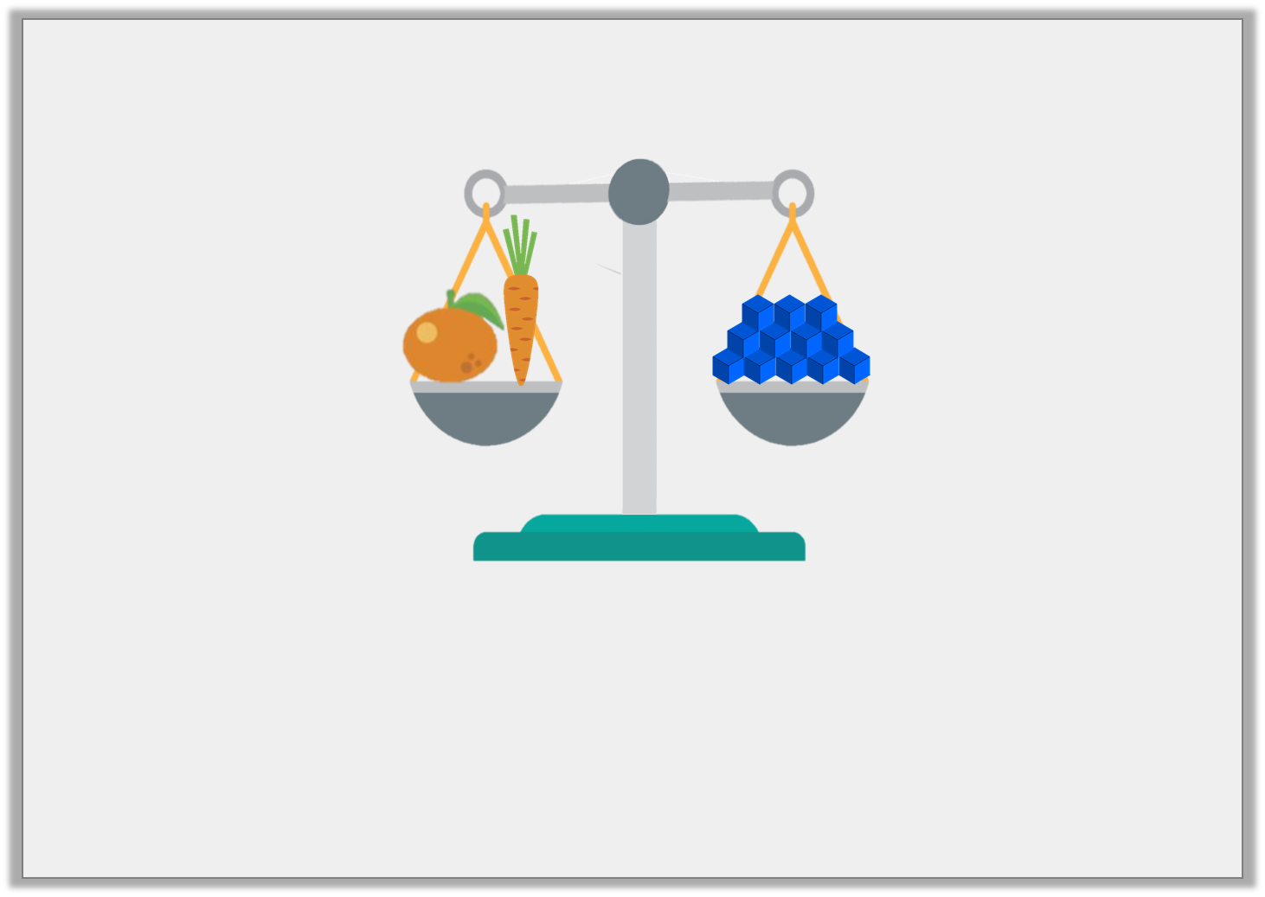
Problem Solving 1
The orange weighs 7 blocks and the carrot weighs 5 blocks.
Draw the blocks to balance the scale.
12 blocks should be drawn on the scale.
© Classroom Secrets Limited 2019

Slide 13
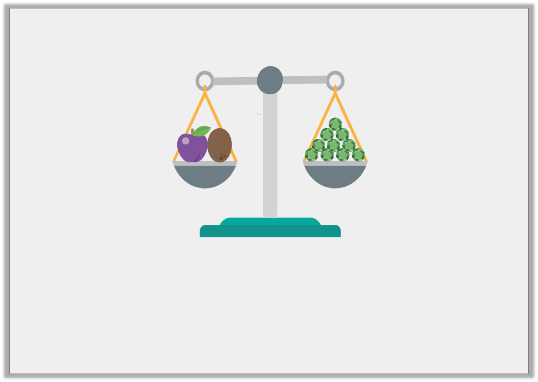
Problem Solving 2
The plum and the kiwi weigh 10 jewels.
Find 3 possible combinations for the mass of the plum and the kiwi.
© Classroom Secrets Limited 2019

Slide 14
Problem Solving 2
The plum and the kiwi weigh 10 jewels.
Find 3 possible combinations for the mass of the plum and the kiwi.
Various answers, for example: plum 4 jewels, kiwi 6 jewels, or plum 3 jewels, kiwi 7 jewels, or plum 9 jewels, kiwi 1 jewel
© Classroom Secrets Limited 2019

Slide 15
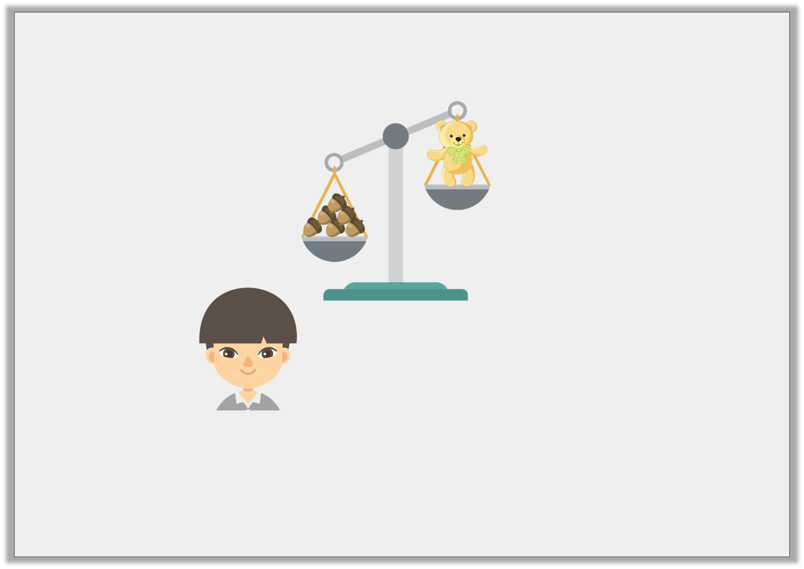
Reasoning 1
Cheng is weighing objects. He says,
Is he correct? Explain your answer.
I think 1 more acorn will balance the scale.
© Classroom Secrets Limited 2019

Slide 16
Reasoning 1
Cheng is weighing objects. He says,
Is he correct? Explain your answer.
No, he is not correct because…
I think 1 more acorn will balance the scale.
© Classroom Secrets Limited 2019

Slide 17
Reasoning 1
Cheng is weighing objects. He says,
Is he correct? Explain your answer.
No, he is not correct because the acorns are already heavier than the teddy. He would need to remove acorns to balance the scale.
I think 1 more acorn will balance the scale.
© Classroom Secrets Limited 2019

